Slide 1

VII SUMMER INTERNSHIP (CS376SI ):Review-1
RV College of
Engineering®
Zero-Trust Edge Video Engine
R Akash Kumar (1RV23CS186) Puneeth R (1RV23CS185)
N Jeevan Reddy (1RV23CS142) Prajwal Roodagi (1RV23CS172
Department of Computer Science,
R V College of Engineering, Bengaluru.
Go, change the world®

Slide 2





Go, change the world®
RV College of
Engineering®
About the Organization and Domain
Institution: Centre of Excellence in RVCE - Center for Computer Vision Research
Mentor: Dr.Poornima Kulkarni
VIDEO PROCESSING AT THE EDGE
1. Camera
Live CCTV / RTSP
2. Edge device
Detect • track •
protect
3. Safe output
Metadata / protected
video
Project focus
Build a local video-processing pipeline that detects objects, protects sensitive regions and produces useful analytics without unnecessarily exposing identities.
Foundation: Open Edge Platform DL Streamer (GStreamer-based video analytics framework).
Planned input modes: live camera stream and recorded video for controlled testing.

Slide 3








Go, change the world®
RV College of
Engineering®
Application of Engineering Knowledge
ENGINEERING METHODS USED IN THE PIPELINE
Video ingest
GStreamer / RTSP
Decode frames
Detection
CV model finds people, vehicles, faces
Tracking
Temporary IDs link
detections across frames
Privacy policy
Choose sensitive
regions to protect
Safe output
Blur / pixelate;
encode or send metadata
Computer Vision
Detection and temporary tracking support people counting, crowd estimation and restricted-zone
events. No face recognition or persistent identity is
required.
Systems Engineering
A streaming pipeline connects input, inference, privacy transformation and output. GPU acceleration can be added where supported by the target hardware.
Evaluation
Compare privacy strength, analytics accuracy, processing speed (FPS), latency and CPU/GPU/memory use on the same test videos.

Slide 4






Go, change the world®
RV College of
Engineering®
Understanding of Industry Operations
Metro Company A
Owns cameras and raw footage
Edge device — our engine
Receives video locally
Detects and temporarily tracks objects Protects faces / license plates
Runs required analytics
Company B
Receives only approved output
Dashboard
Counts, crowd alerts, safe video
What can be sent?
Analytics metadata: entries/exits, occupancy, crowd level, restricted-zone alert.
Optional protected video: useful scene view with faces/plates obscured.
What should not be sent?
Raw identifiable frames, readable faces/plates, face embeddings or
persistent identity records—unless a separate, explicitly authorized need
exists.

Slide 5

Go, change the world®
RV College of
Engineering®
Organizational Hierarchy
Centre of Excellence in Computer Vision Research(Next Generation AI Enabled)
R V College of Engineering
Principal & Institutional Leadership
Centre of Excellence in Computer Vision Research
Established: 2021
Vision · Mission · Strategic Direction
⇄
External Stakeholders
Industry Partners (CCTV/Video Surveillance)
Government & Standardization Bodies
MoUs with Industries Industry Advisory Board
Coordinators
Dr. Ramakanth P | Dr. K. Sreelakshmi | Dr. Azra Nasreen
Faculty Leadership & Research Coordination
▣
Research Verticals
Infrastructure & Lab Facilities
▤
Research & Innovation
Research Scholars + Student Teams
Projects · Research · Prototypes · Publications · Competitions

Slide 6
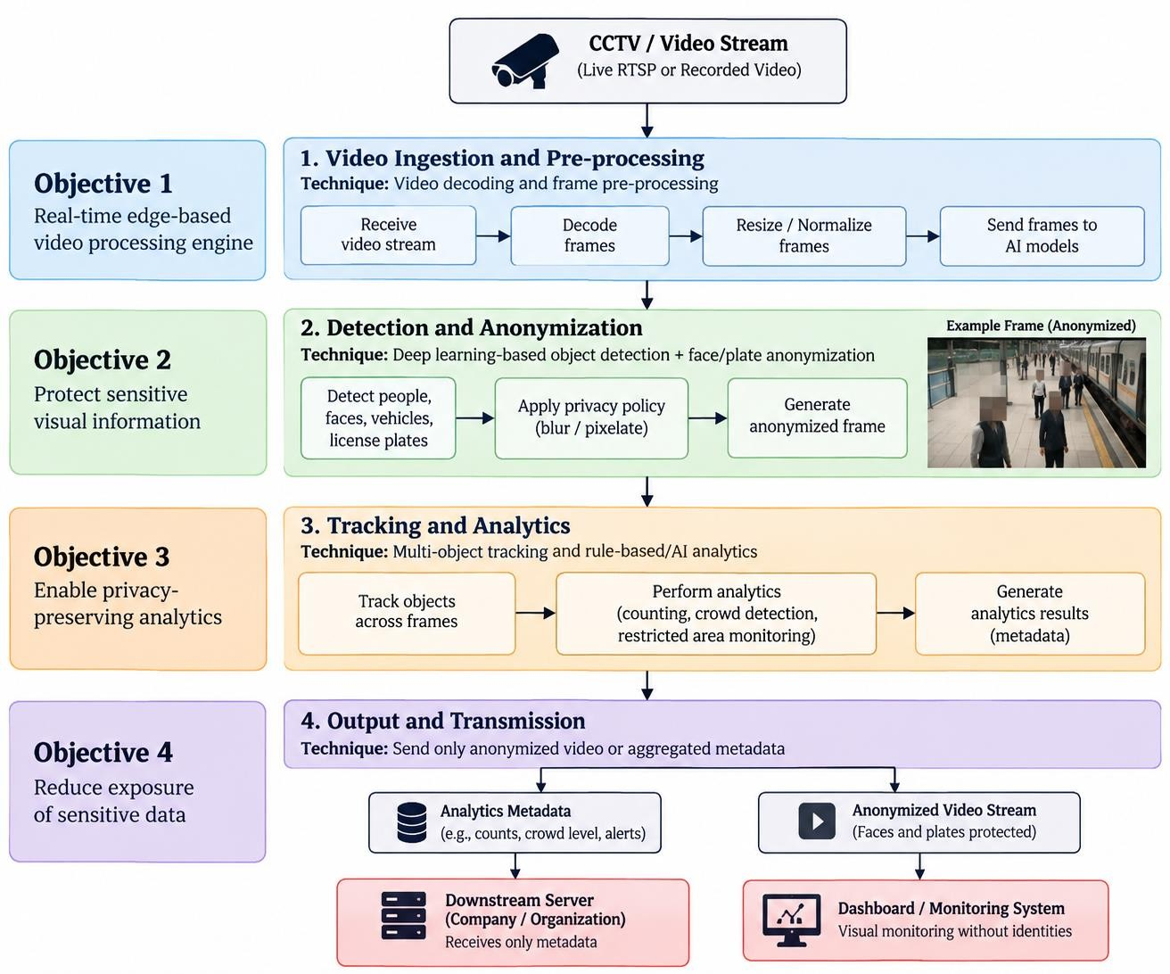
Go, change the world®
RV College of
Engineering®
Proposed Methodology

Slide 7
















Go, change the world
RV College of
Engineering®
Tasks carried out
®
Tasks carried out: Proposed System Architecture
PROJECT WORK / TASKS
Studied DL Streamer as the video-pipeline foundation.
PROPOSED PIPELINE
Input
RTSP / MP4
Compared related repositories for anonymization and tracking, including EgoBlur and
ByteTrack.
Detect
People / faces / plates
Mapped the system flow: ingest → detect → track → protect → analytics → safe output.
✓
Defined the privacy boundary and the two output modes: metadata-only or anonymized video.
Protect
Blur / pixelate
✓
Identified evaluation measures: FPS, latency, analytics accuracy, privacy leakage and
resource usage.
Analyze
Count / crowd / zones
✓
Outlined live RTSP input as the target mode and recorded video as a repeatable test
mode.
Output
Metadata / safe video
Implementation status: architecture and component selection; prototype/evaluation to be
completed as applicable.

Slide 8
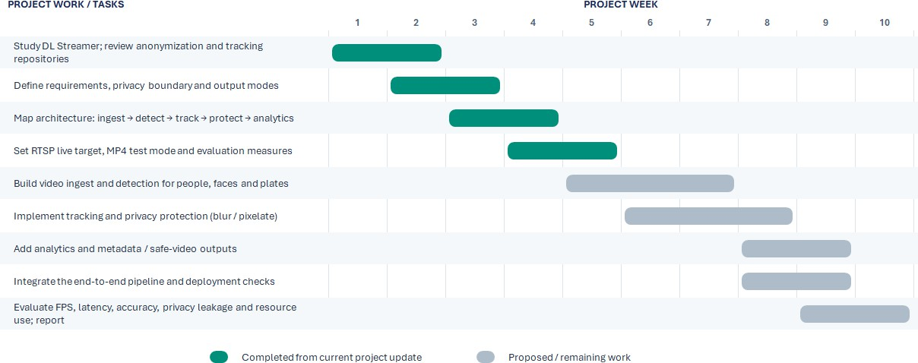
Go, change the world
RV College of
Engineering®
Tasks carried out
®
Tasks carried out: Timeline

Slide 9
References
RV College of
Engineering®
Go, change the world®
M. Wang, S. Li, X. Zhang, and G. Feng, “Facial privacy in the digital era: A comprehensive survey on methods, evaluation, and future directions,” Computer Science Review, vol. 58, Art. no. 100785, 2025, doi: 10.1016/j.cosrev.2025.100785.
S. Ravi, P. Climent-Pérez, and F. Florez-Revuelta, “A review on visual privacy preservation techniques for
active and assisted living,” Multimedia Tools and Applications, vol. 83, pp. 14715–14755, 2024, doi: 10.1007/s11042-023-15775-2.
M. H. Jimenez, O. Toker, and L. G. Jaimes, “VERA: A privacy-preserving framework for deep learning data collection and object detection in private settings,” Applied Sciences, vol. 16, no. 4, Art. no. 2144, 2026.
S. De Coninck, W.-C. Wang, S. Leroux, and P. Simoens, “Privacy-preserving visual analysis: Training
video obfuscation models without sensitive labels,” Applied Intelligence, vol. 54, no. 8, pp. 6041–6052, 2024.
J. Yuan, Z. Wang, T. Yuan, J. Zhang, and R. Qian, “Pimo: Memory-efficient privacy protection in video
streaming and analytics,” Multimedia Systems, vol. 30, Art. no. 137, 2024, doi: 10.1007/s00530-024-01337-5.
M. A. Khan, H. Menouar, R. Hamila, and A. Abu-Dayya, “Crowd counting at the edge using weighted knowledge distillation,” Scientific Reports, vol. 15, Art. no. 11932, 2025.

Slide 10
References
RV College of
Engineering®
Go, change the world®
T. Li, H. Wang, Q. Li, Y. Jiang, and Z. Yuan, “CL-Shield: A continuous learning system for protecting user privacy,” IEEE Transactions on Mobile Computing, vol. 24, no. 4, pp. 3148–3162, 2025.
M. A. Azad, S. Abdullah, J. Arshad, H. Lallie, and Y. H. Ahmed, “Verify and trust: A multidimensional survey of zero-trust security in the age of IoT,” Internet of Things, vol. 27, Art. no. 101227, 2024, doi: 10.1016/j.iot.2024.101227.
C. Lachner, T. Rausch, and S. Dustdar, “A privacy preserving system for AI-assisted video analytics,” in
Proc. 2021 IEEE 5th International Conference on Fog and Edge Computing (ICFEC), 2021, pp. 74–78, doi: 10.1109/ICFEC51620.2021.00018.
Y. Kim, S. Yun, I.-N. Wang, K.-W. Lee, and J. Jeong, “A study of a frequency-separation-based and access-controlled reversible video de-identification system for edge environments,” in Proc. 2026 International Conference on Ubiquitous and Future Networks (ICUFN), 2026, pp. 653–658, doi:
10.1109/ICUFN69619.2026.11628792

